Slide 1
DS 7333 – Quantifying the World
Live session - 1
Course Introduction & Overview

Slide 2
Welcome to Quantifying the World
Brief Bio
Despite having (2) Masters’ degrees, I am not a doctor – please feel free to refer to me simply as “Brad” throughout this course.
In addition to being an Adjunct Professor with SMU’s Data Science program, I am a full-time employee of PwC, where I serve as a Director within our PwC Intelligence organization, and an independent data science consultant authorized to perform “outside activities.”
Most importantly, I am a husband and father and have firsthand experience “having a family” while working and attending school full-time.
“My name is Brad Blanchard, and I will be your Quantifying the World professor.”

Slide 3












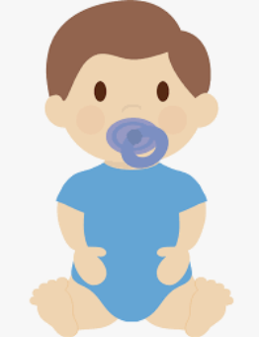

About Me
Education
Work
Family
Count
2
4
6
8

Slide 4
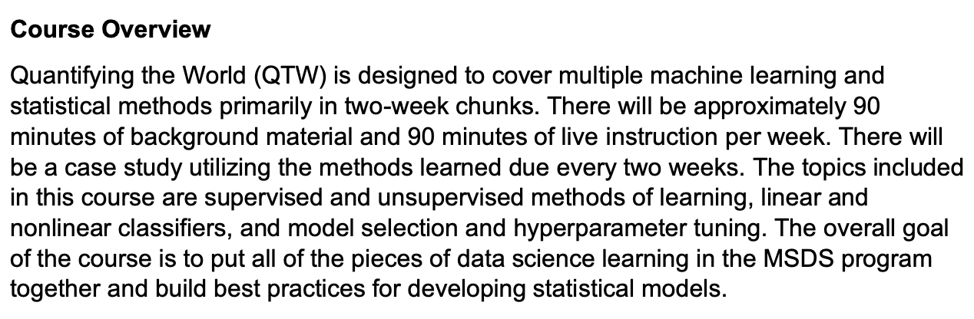
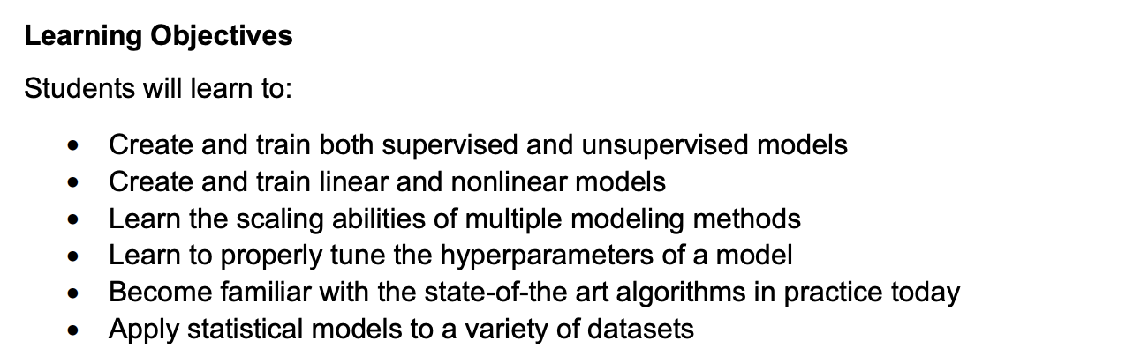
Course Overview & Objectives
Quick Notes:
All Video Lectures have been pre-recorded by Dr. Robert Slater
All questions related to the course materials, syllabus, and grading should be sent to (bablanchard@smu.edu) where I will respond within 24-hours
I’m here to help – but I can’t help if you don’t ask – do not be shy!
Every detail of the course can be found in the Syllabus – please read it.

Slide 5
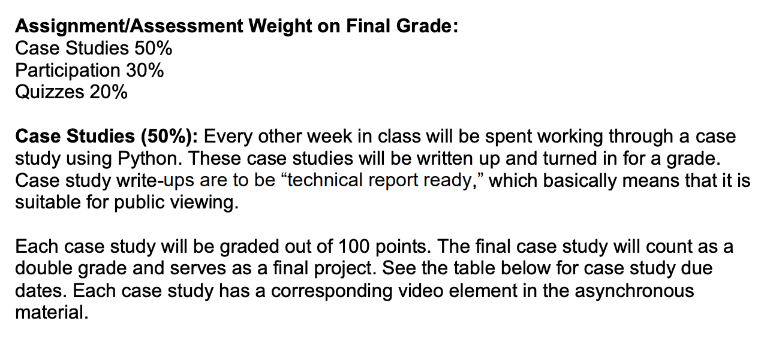
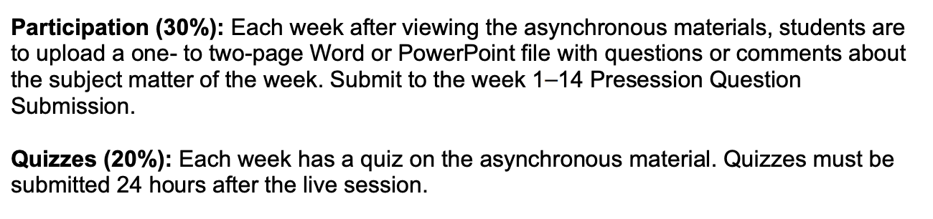
Assignments & Grading
Quick Notes:
All assignments can (and should) be completed in groups
Case studies will be due by 11:59pm (central) after our live session (see the calendar on the next slide)
Be sure to list each group member at the top of your case submission
Participation submissions and Quizzes for the week are due each Thursday by 11:59pm (central)

Slide 6
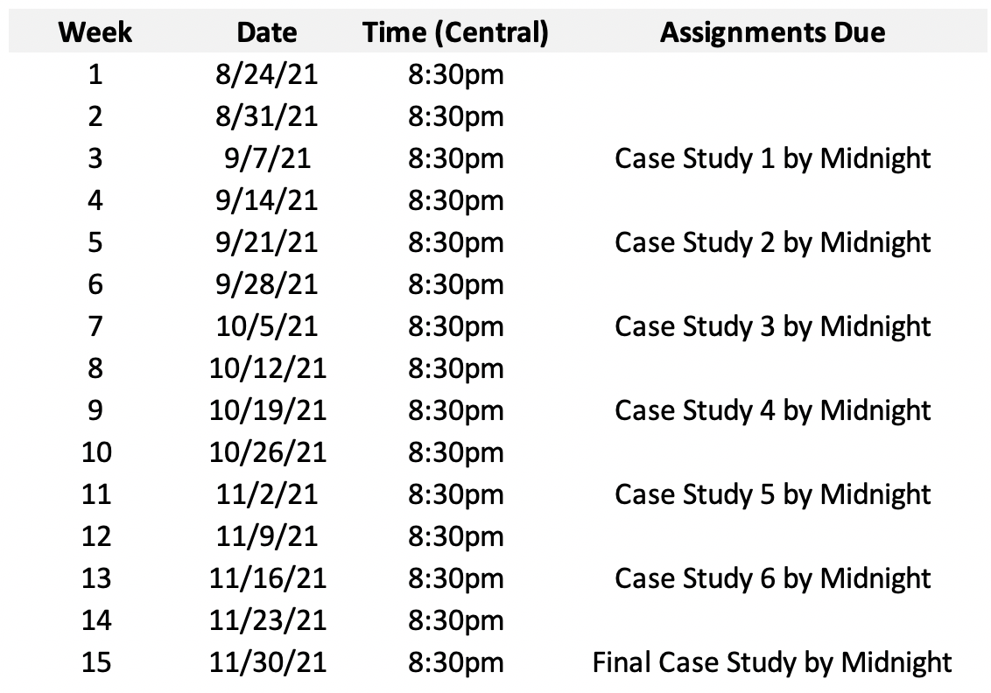
Course Calendar
Quick Notes:
All meetings have been scheduled in 2DS and can be accessed through the “Meetings” section
There will be a 5-point deduction for each day a case submission is late (submissions more than 2-days late will not be accepted)
The Final Case study is worth double

Slide 7
Group Grading
I reserve the right to assign individual grades to group members when there is adequate evidence of unequal contributions amongst team members
I will work to provide clear grading feedback with each submission; however, please note that more exhaustive feedback can come through an individual or team Zoom meeting (please feel free to reach out to me should you want to have a more thorough discussion).
Note that this field seldom has “right or wrong” answers – often there are more or less efficient ways to solve a problem. Said another way, these submissions can be subjective in-nature – my grading may be evident of that reality.
Quick Notes:
I will allow you to form your own groups of up to 3-4 members
Please attempt to address group issues amongst yourselves before inviting me into the conversation
You are free to change groups throughout the course; just note contributors at the top of each submission

Slide 8
Contact Information
Please contact me at anytime through my SMU email address:
bablanchard@smu.edu
I will reply to all emails within 24-hours of their receipt (and within hours in most circumstances), however, to assist me in monitoring course-related emails, please add the below prefix to the Subject Line of all emails:
QTW Student – [Additional Subject Context Here]
All meetings and office hour interactions will take place over Zoom.
Quick Notes:
For security and privacy, I will not be providing you with my personal cell phone number
I will make every effort to monitor my inbox more closely leading up to Project submission deadlines in the event you have an urgent issue
I will plan to be available for 30-minutes after each Live Session to assist with any immediate questions you may have or personal matters you may be working through

Slide 9
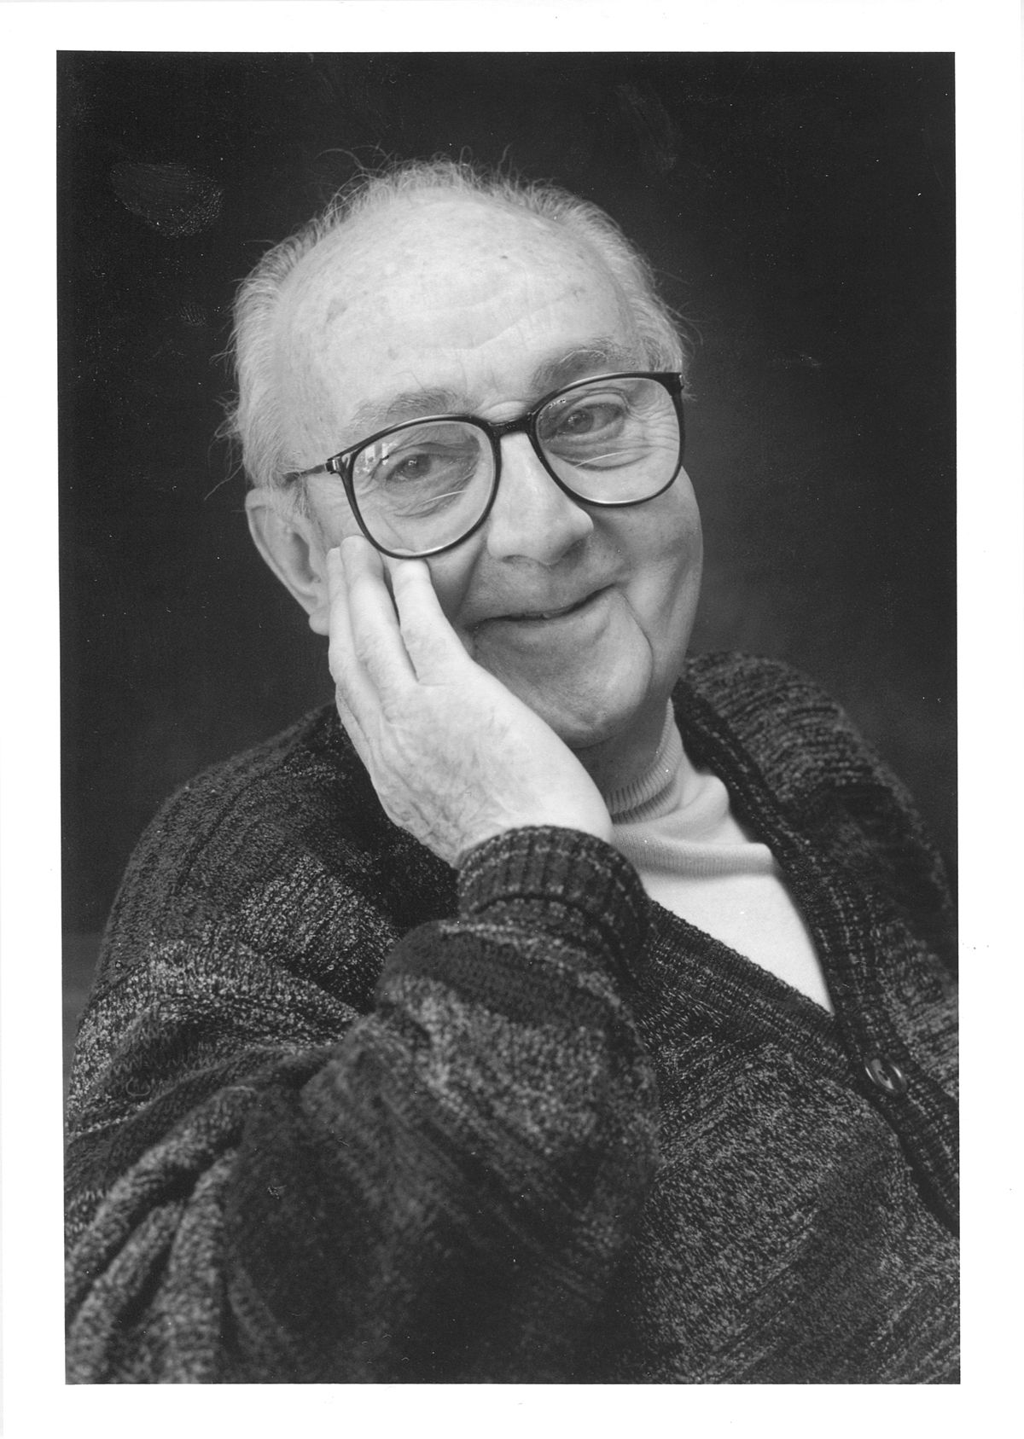
Final Words
“All models are wrong
but some are useful.”
George Box, famous statistician

